Slide 1
Basic Statistics for Data Science
Hypothesis Testing

Slide 2
Topics Covered
Hypothesis Testing
Overview
Test Scores and P-value
One-tailed vs Two-tailed Hypothesis tests
Steps in Hypothesis testing
Errors in Hypothesis testing
Illustrations

Slide 3
Logic of Hypothesis Testing
Claim about a population parameter
Sample data is collected and analysed
If data contradicts claim, then claim is rejected
Mileage of vehicles
Efficiency of a drug
Average age of employees
Average salary of Data Scientists
Amount of fat content in food
Accuracy of a test
Placement ratio of universities
Effectiveness of a training program
…

Slide 4
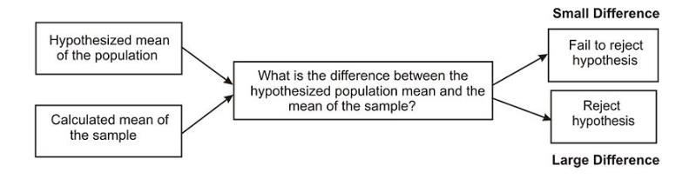
Hypothesis Testing
Hypothesis Testing is a statistical technique where a claim regarding a population parameter is tested by means of sample data
Example – Testing the claim about average salary of women in IT field by collecting the income data for a sample set
When a hypothesis is tested, a statistician must decide on how much of a difference between the claim and sample mean is necessary in order to reject the null hypothesis
A level of significance or alpha (α) is chosen for the hypothesis test which indicates how improbable a sample mean must be in order to be deemed significantly different from the claimed mean
Industry standard values for α are 0.05 and 0.01 corresponding to 95% and 99% confidence levels respectively

Slide 5
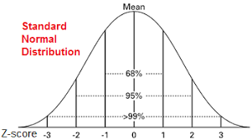
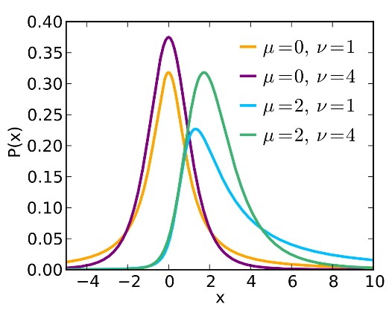
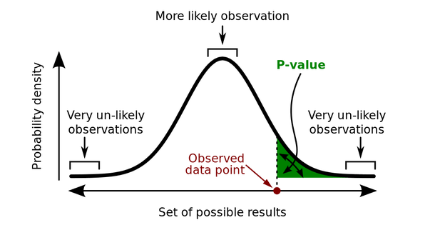
Z-score, t-score and P-value
Z score
The Z-score is a test statistic for Z-tests that measures the difference between an observed statistic and its hypothesized population parameter in units of standard error.
Converting an observation to a Z-value is called standardization. To standardize an observation in a population, subtract the population mean from the observation of interest and divide the result by the population standard deviation. The result of these calculations is the Z- value associated with the observation of interest
t-score
The t-score is a test statistic for t-tests that measures the difference between an observed sample statistic and its hypothesized population parameter in units of standard error.
A t-test compares the observed t-value to a critical value on the t-distribution with (n-1) degrees of freedom to determine whether the difference between the estimated and hypothesized values of the population parameter is statistically significant
P-value
P-value is the probability of observing a data point as close to the hypothesized mean
Z Distribution
t Distribution
P value

Slide 6
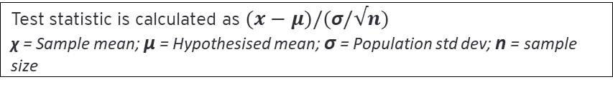
Hypothesis Testing – Steps for Z-test
Problem Statement
Problem statement with details of sample size, sample mean, population standard deviation and claim about population mean
Formulation of Null and Alternate Hypotheses
Null Hypothesis, H₀ = Population mean claimed in problem statement
Alternate Hypothesis, H_{a} = Value of parameter contradicting the claim
Calculation of Test statistic
Test statistic is calculated as $(x−μ)/(\text{σ}/√n)$
χ = Sample mean; μ = Hypothesised mean; $\text{σ}$ = Population std dev; n = sample size
Cut-off value for Z-statistic
Cut off value for the Z-test statistic is calculated as: NORM.INV(α,0,1)
α = probability of Type 1 Error;
Inferences
If abs(Test statistic) > abs(Cut-off value), then reject Null Hypothesis, H₀;
Else Do not reject Null Hypothesis, H₀

Slide 7
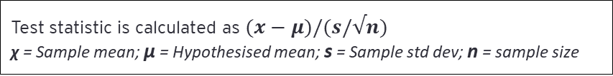
Hypothesis Testing – Steps for t-Test
Problem Statement
Problem statement with details of sample size, sample mean, sample standard deviation and claim about population mean
Formulation of Null and Alternate Hypotheses
Null Hypothesis, H₀ = Population mean claimed in problem statement
Alternate Hypothesis, H_{a} = Value of parameter contradicting the claim
Calculation of Test statistic
Test statistic is calculated as $(x−μ)/(s/√n)$
χ = Sample mean; μ = Hypothesised mean; s = Sample std dev; n = sample size
Cut-off value for t-statistic
Cut off value for the t-test statistic is calculated as: T.INV(α, n-1)
α = probability of Type 1 Error; n = sample size
Inferences
If abs(Test statistic) > abs(Cut-off value), then reject Null Hypothesis, H₀;
Else Do not reject Null Hypothesis, H₀

Slide 8
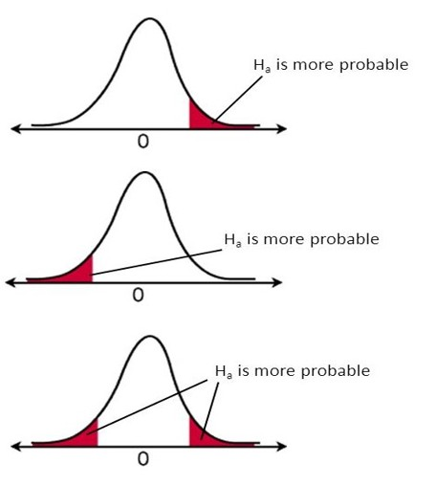
One-tailed vs Two-tailed test
Right tailed Test
H₀ : μ <= claimed value
H_{a} : μ > claimed value
Choice of Test statistic
Is the Population standard deviation known?
Yes
No
Left tailed Test
H₀ : μ >= claimed value
H_{a} : μ < claimed value
Is the sample size
more than 30?
Yes
Use t-score
Two tailed Test
H₀ : μ = claimed value
H_{a} : μ ≠ claimed value
Yes
Use Z-score

Slide 9
Errors in Hypothesis Testing
Reality
Null Hypothesis is True
Null Hypothesis is False
Conclusion from Hypothesis test
Reject
Null Hypothesis
Type 1 Error (α)
[False Positive]
Correct outcome (1- β)
[Power of test]
Fail to reject
Null Hypothesis
Correct Outcome
Type 2 error (β)
[False Negative]

Slide 10
Illustrations

Slide 11
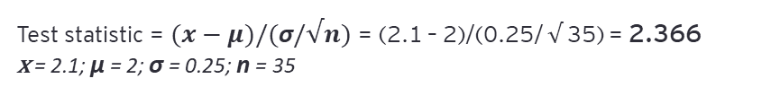
Hypothesis Testing – Case Study 1
Problem Statement
The food label on a cookie bag states that there are at most 2 grams of saturated fat in a single cookie. In a sample of 35 cookies, it is found that the mean amount of saturated fat per cookie is 2.1 grams. Assume that the population standard deviation is 0.25 grams. At .05 significance level, can we reject the claim on food label?
Formulation of Null and Alternate Hypotheses
Parameter of interest : Amount of saturated fat per cookie
Null Hypothesis, H₀ : μ <= 2
Alternate Hypothesis, H_{a} : μ > 2
Calculation of Test statistic
Test statistic = $(x−μ)/(\text{σ}/√n)$ = (2.1 – 2)/(0.25/ $√$35) = 2.366
x = 2.1; μ = 2; σ = 0.25; n = 35
Cut-off value for Z-statistic
Cut off value = NORM.INV(α,0,1)
= NORM.INV(0.05,0,1) = 1.645
Inferences
Test statistic 2.366 > cut-off value 1.645
Hence, at .05 significance level, we reject the claim that there is at most 2 grams of saturated fat in a cookie

Slide 12
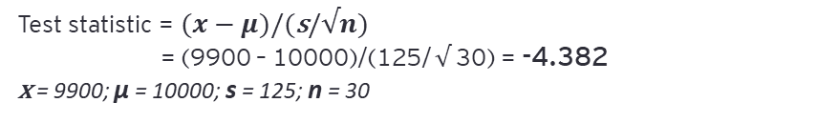
Hypothesis Testing – Case Study 2
Problem Statement
The manufacturer claims that the mean lifetime of a light bulb is more than 10,000 hours. In a sample of 30 light bulbs, it was found that they only last 9,900 hours on average. Assume the sample standard deviation is 125 hours. At .05 significance level, can we reject the claim by the manufacturer?
Formulation of Null and Alternate Hypotheses
Parameter of interest : Amount of saturated fat per cookie
Null Hypothesis, H₀ : μ > 10000
Alternate Hypothesis, H_{a} : μ <= 10000
Calculation of Test statistic
Test statistic = $(x−μ)/(\text{s}/√n)$
= (9900 – 10000)/(125/ $√$30) = -4.382
x = 9900; μ = 10000; s = 125; n = 30
Cut-off value for t-statistic
Cut off value = T.INV(α, n-1) = T.INV(0.05, 29) = -1.699
Inferences
Test statistic 4.382 > cut-off value 1.699
Hence, at .05 significance level, we reject the claim that the mean lifetime of a light bulb is more than 10000 hours

Slide 13
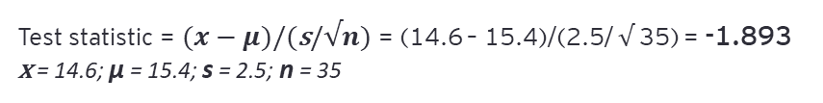
Hypothesis Testing – Case Study 3
Problem Statement
The mean weight of penguins found in an Antarctic colony last year was 15.4 kg. In a sample of 35 penguins same time this year in the same colony, the mean penguin weight is 14.6 kg. The sample standard deviation is 2.5 kg. At .05 significance level, can we reject the claim that the mean penguin weight does not differ from last year?
Formulation of Null and Alternate Hypotheses
Parameter of interest : Mean weight of penguins
Null Hypothesis, H₀ : μ = 15.4
Alternate Hypothesis, H_{a} : μ ≠ 15.4
Calculation of Test statistic
Test statistic = $(x−μ)/(\text{s}/√n)$ = (14.6 – 15.4)/(2.5/ $√$35) = -1.893
x = 14.6; μ = 15.4; s = 2.5; n = 35
Cut-off value for t-statistic
Cut off value = T.INV(α/2, n-1) = T.INV(0.05/2, 34) = -2.032
Inferences
Test statistic 1.893 < cut-off value 2.032
Hence, at .05 significance level, we fail to reject the claim that the mean penguin weight does not differ from last year

Slide 14
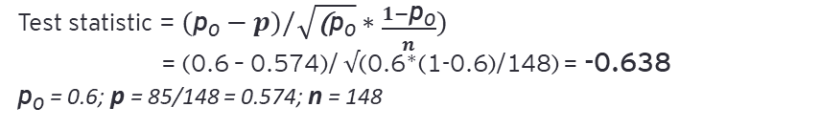
Hypothesis Testing – Case Study 4
Problem Statement
Suppose 60% of citizens voted in last election. 85 out of 148 people in a telephone survey said that they voted in current election. At 0.5 significance level, can we reject the claim that the proportion of voters in the population is above 60% this year?
Formulation of Null and Alternate Hypotheses
Parameter of interest : Proportion of voters
Null Hypothesis, H₀ : p₀ > 0.6
Alternate Hypothesis, H_{a} : p₀ <= 0.6
Calculation of Test statistic
Test statistic = $(\text{p}\text{0}−p)/\sqrt{\text{(}\text{p}\text{0}}∗\frac{1−\text{p}\text{0}}{n})$
= (0.6 – 0.574)/ $√$(0.6*(1-0.6)/148) = -0.638
p₀ = 0.6; p = 85/148 = 0.574; n = 148
Cut-off value for Z-statistic
Cut off value = NORM.INV(α,0,1) = NORM.INV(0.05,0,1) = -1.645
Inferences
Test statistic 0.638 > cut-off value 1.645
Hence, at .05 significance level, we fail to reject the claim that the proportion of voters is above 60% this year

